Slide 1
QUIZ
How many types of errors detections you read, enlist and explain any two.
Email the image of your answer to your respective CR and maximum time
Is 5 minutes

Slide 2
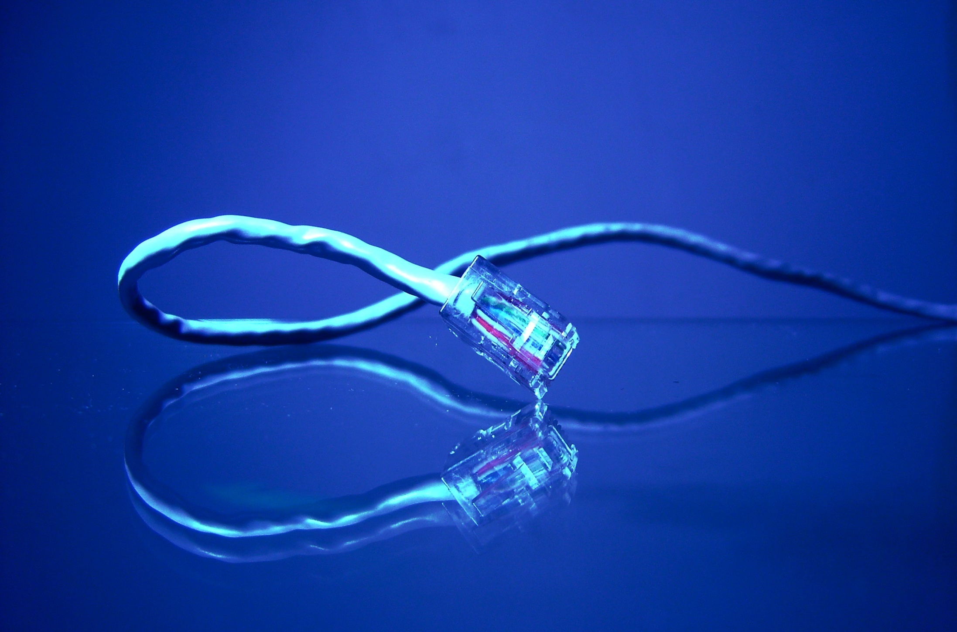
OT - General Discussion
Applying of theory learnt to date
Notes:
Today’s lecture (discussion?) is about how can we apply the networking theory we’ve learnt to date to build our own computer networks.

Slide 3
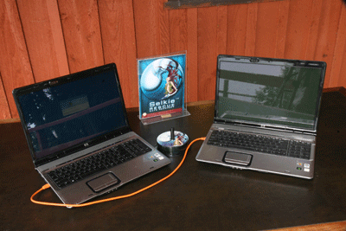
Scenario 1: PC to PC
Notes:
The simplest network that we might want to build is to connect two computers back to back.
While, such a network appears to overly simplistic, a lot of things have to work together for two computers connected back-to-back to exchange data. We will cover these requirements in the following slides.

Slide 4
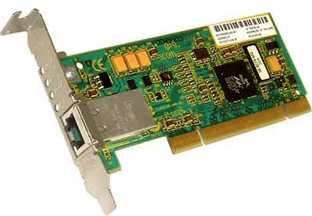
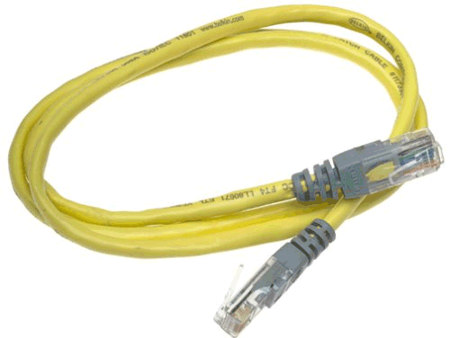
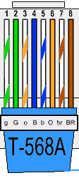
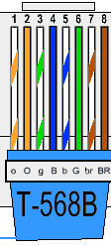
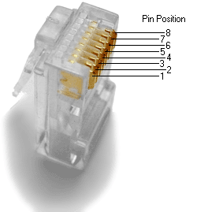
Scenario 1: PC to PC
Crossover Cable
Notes:
First of all, we need network interface cards (NICs) installed at both the PCs. Assume that we want to use the Ethernet NICs (or network adapters – as they’re called) due to ready availability in all commodity PCs and notebooks.
If the computer does not have a NIC, we’ll have to install one on each computer. The NIC may be an expansion card that fits on the motherboard of the computer (such as a PCI slot NIC) or it may be already installed as part of the motherboard (as is increasingly the case in recent motherboards). As we’ve studied, the NIC is responsible for functionality on the nodes (till the data link layer). The network layer (most of it anyways) is implemented in software. While the NIC is itself a hardware and contains many L2 functions embedded in the hardware, it also requires a device driver which is its accompanying software that must be installed for the computer to recognize the NIC.
While the NICs are necessary for computers to communicate, we also need a transmission medium on which to convey the bits. The simplest approach is to connect them using UTP Cat5 Cables. For two computers to communicate directly (without any router/ switch/ hub in between), the NICs must be connected through a crossover cable.
An Ethernet crossover cable is shown above. An Ethernet crossover cable crosses wires between both end points to ensure that the Tx of one computer is connected to the Rx and vice versa. In the figure shown above, between the two end points, wires 1 and 3 are interchanged as well as wires 2 and 6.
A general rule-of-thumb is that similar devices (for examples, 2 PCs, 2 Switches, 2 Routers) are connected using crossover cables.
Therefore, if you want to connect two PCs directly (without using any intermediate device), you must use Ethernet crossover cable.

Slide 5
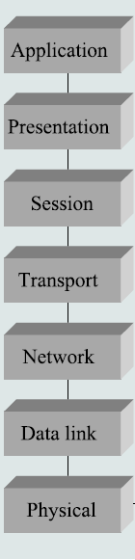
Scenario 1: PC to PC
Application layer software must also be installed. For example, browser and webserver.
TCP/ IP stack is implemented on all modern OS
Notes:
Up till now, we have covered the hardware requirements.
We also need to install networking software on computers for them to communicate (even for a very simple network such as two directly connected PCs). Luckily, networking software (implementation of TCP/ IP stack) is now available on all modern OS (such as Linux/ Windows, etc.)
Therefore, we don’t need to worry about installing TCP/ IP software. The TCP/ IP software also allows to internetwork and interconnect devices in different networks. The TCP/ IP stack usually spans from L1 (Physical layer) to L4 (Transport layer).
We will need to install specific application layer software to communicate over a network. For example, in our example setting, we’d like to exchange files between the two computers connected back-to-back using the HTTP protocol (which is a client-server based protocol). For this transfer to take place, we need to install a webserver application layer software (e.g., Microsoft’s IIS and Apache webservers – you’re also doing these webservers as part of your term project) as well as a browser software (e.g., Microsoft’s Internet Explorer or Mozilla Firefox). These application layer software are coded as per the specification of the respective application layer protocol.

Slide 6
Scenario 1: PC to PC
In back-to-back connected computers, the data-link technology should be same.
Also, both machines should be on same network
Notes:
Now, we have covered the hardware/ software requirements of building a simple back-to-back connection between two computers.
The last point to note is that we’re using the same data-link layer technology on both networks (in this case it is Ethernet). For back-to-back connected computers to communicate, it’s necessary that both of them use the same data-link layer technology.
Also, the network layer address configured on both machines should correspond to a single shared network.
If we ensure all the steps listed in this slide and the last few slides, we should have a network up and ready.
---------
Question: What happens if we want to use a protocol other than HTTP for the file transfer? Let’s say we want to use FTP server.

Slide 7
Scenario 1: PC to PC
B
A
B
Let‘s allocate an IP address to A
Assume, we choose an address 192.168.0.1/16
Typically, private addressing class is used:
10.0.0.0/8; 172.16.0.0/12; 192.168.0.0/16s
Notes:
Let’s now see how an IP address may be configured.
Typically three IP classes 10.0.0.0/8, 172.16.0.0/12, and 192.168.0.0/16 are used for private addressing.
While it’s not necessary for computers to use the IP addresses above if they’re not connected to the Internet, it’s advisable to use the classes above especially if, sometime in future, it is decided to connect these computers to the Internet.
Remember that IP addresses on the Internet have to be bought and you can use only the IP addresses you’ve bought (or your ISP has bought).

Slide 8
Scenario 1: PC to PC
B
A
B
For communication, B has to be given IP belonging to the same network class (i.e., 192.168.0.0/16)
An example IP address that will allow communication is:
192.168.15.2/16
Only the first two octets have to be same since the network bits are the first 16 bits (/16)
Notes:
We have now seen how to build a single network using point-to-point links, shared media, and switches. The problem is that lots of people have built networks with these various technologies and they all want to be able to communicate with each other, not just with the other users of a single network. This topic is about the problem of interconnecting different networks.

Slide 9
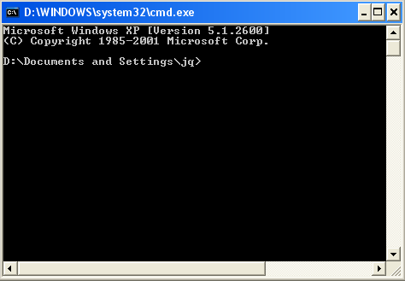
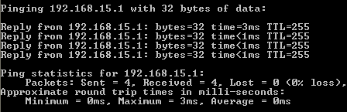
Scenario 1: Testing Connectivity
ping 192.168.15.1
B
If ICMP reply is received, network connectivity is present
ICMP Request
B
A
192.168.0.1/16
192.168.15.1/16
Notes:
Lastly, how do we check if the networks we’ve made is actually connected.
The answer is by using a command called ‘ping’ which uses ICMP (Internet Control Message Protocol)’s echo request and echo reply to verify if the network connectivity is established.
If the destination node (the node being pinged) replies the ICMP request, and the reply packet reaches the source, this implies that there’s network connectivity.

Slide 10
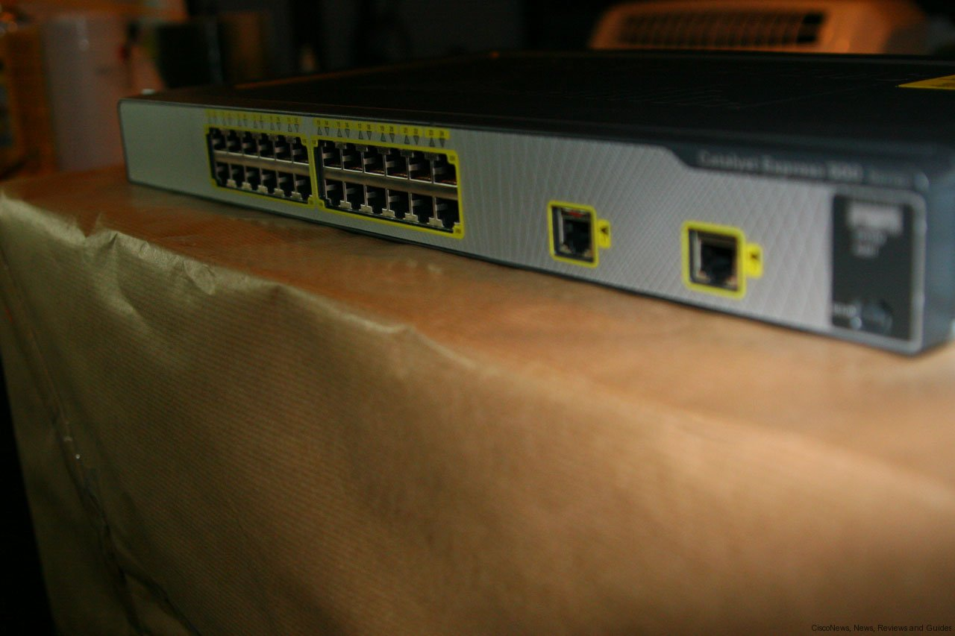
Scenario 2: more than 2 PCs
Notes:
Now we move on to a more interesting problem – connecting more than 2 nodes. This may be applicable if, e.g,. we want to connect multiple computers in a hostel.

Slide 11
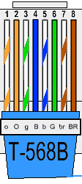
Scenario 2: more than 2 PCs
Straight Cable
Notes:
Typically, we use a networking device such as a hub or a switch.
A hub is a more cheaper option but does not provide good performance when the number of nodes increase.
A switch provides better bandwidth since it segments (breaks down) collision domains.
It’s to be noted that while connecting a PC to a hub/ switch (dissimilar devices), we use straight through cable in which the wire order remains the same. The switching between the Tx and Rx wires is done internally inside the switch/ hub.
As a general rule-of-thumb, dissimilar devices are connected using straight cables while similar devices are connected using cross cables.

Slide 12
Some Networking Products
Notes:
Now, I will show you pictorially some networking products. While all the products shown belong to Cisco Systems, Cisco is by no means the only networking product manufacturer (although, it is the most popular manufacturer). The aim of showing these pictures is to simply show you how routers/ switches look like so that you may be able to recognize one once you see them.
While, it has been in the previous lectures that routers do not have to be special-purpose hardware and they can be housed in a general-purpose PC (which performs the routing in software), typically due to performance reasons, routers are implemented in hardware.

Slide 13
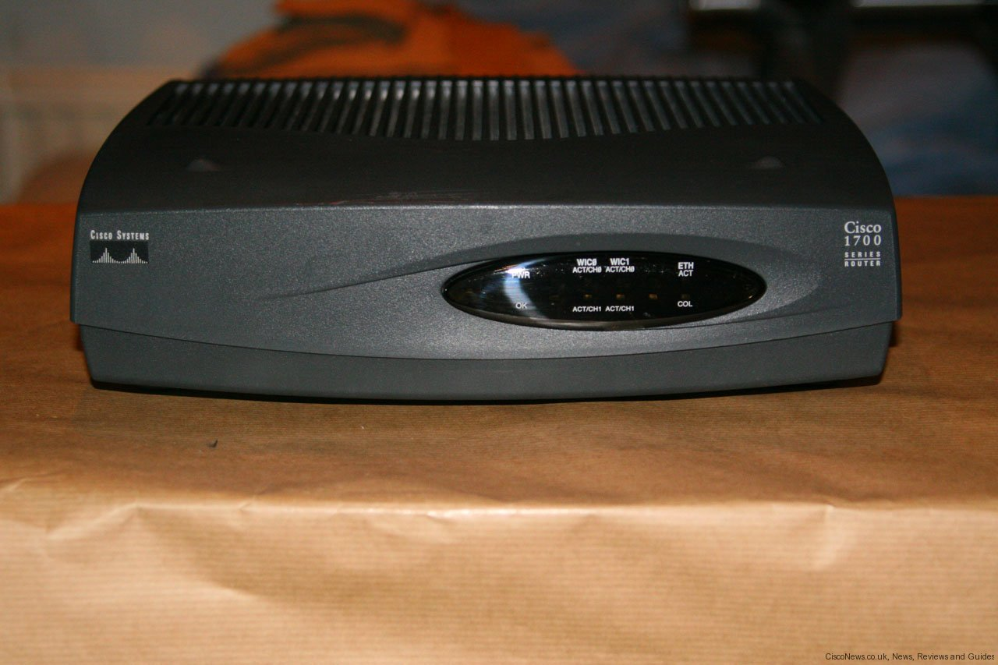
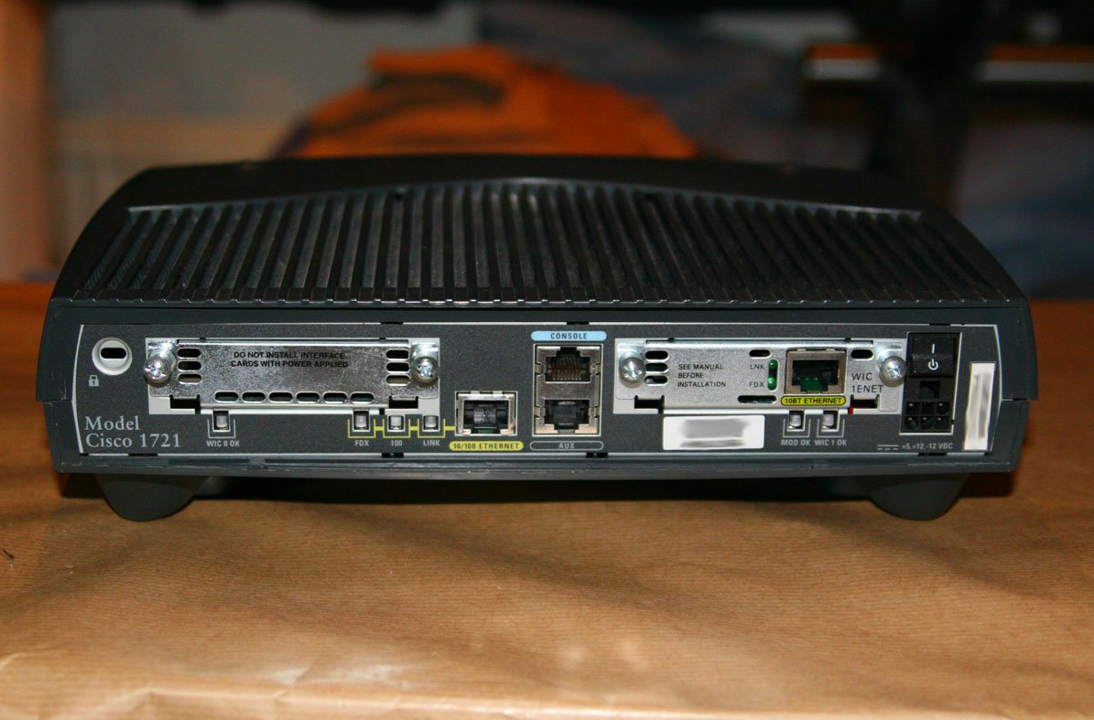
SOHO Router – Cisco 1721

Slide 14
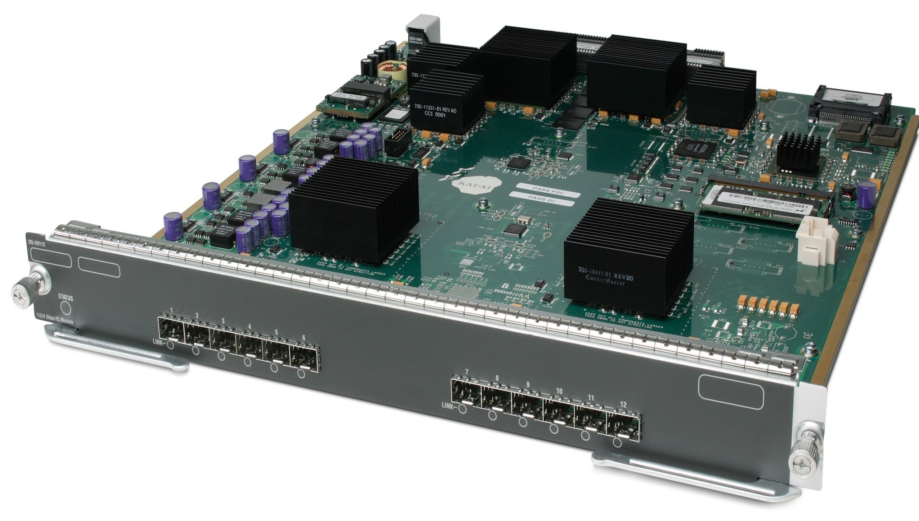
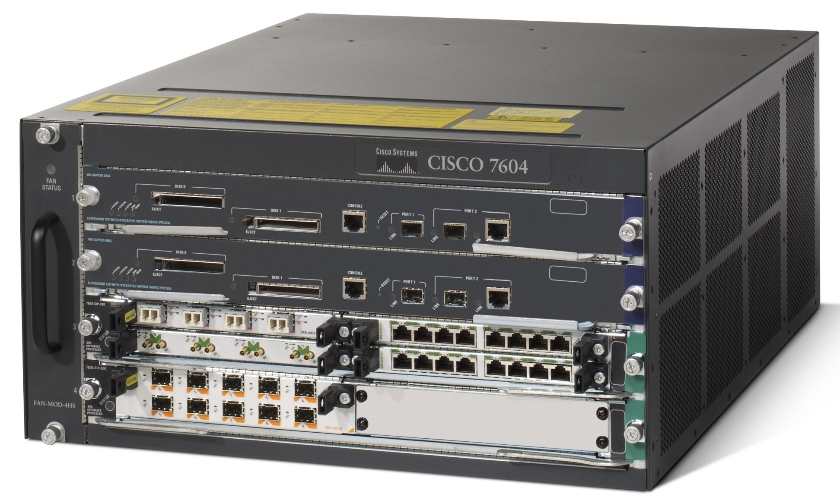
Modular Router – Cisco 7604
Gigabit Ethernet Router Module
Modular Router – Cisco’s 7604 Router

Slide 15
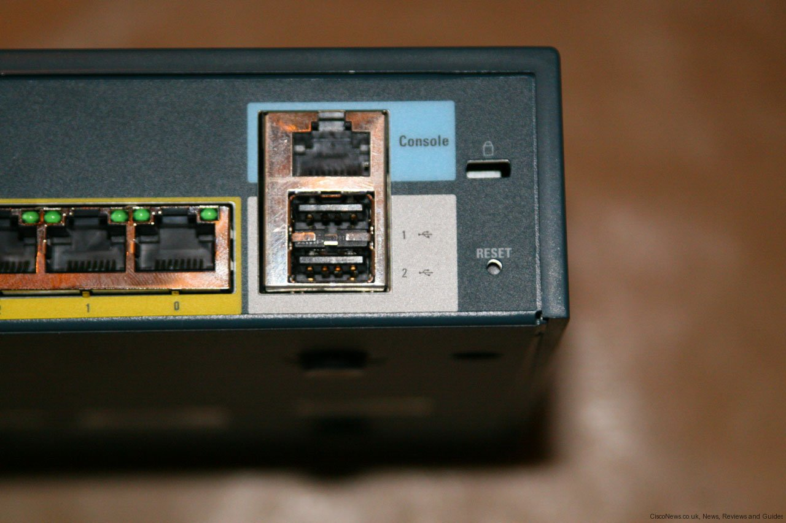
Connecting to Router
Notes:
A console port is used to connect a terminal directly to the router.
This port is often used for configuration by the network administrator or used when other forms of connectivity to the router (e.g., via Ethernet) is not available due to any reason. It can be thought as the most direct way of accessing (and configuring) a router.

Slide 16
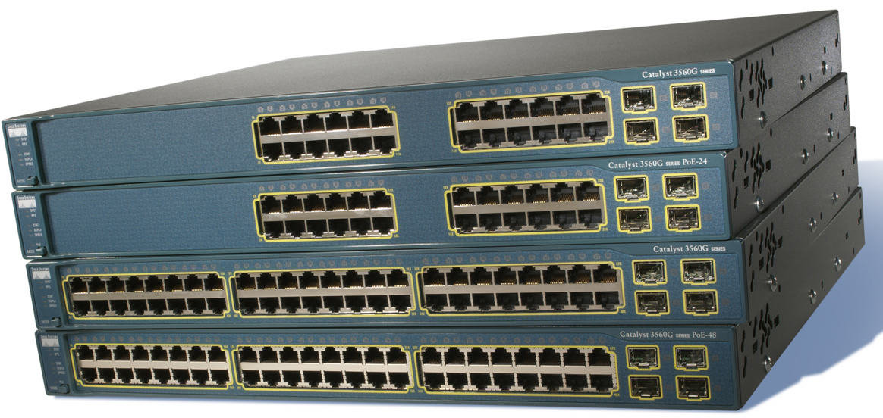
Switch – Cisco Catalyst 3560

Slide 17
?
?
Questions/ Confusions?
?
Use the discussion forum at:
http://compnets.ning.com/
Credits/ Acknowledgement at:
http://sites.google.com/site/cse320site/

